Slide 1
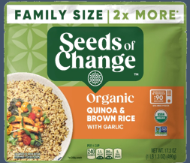




Graham McCulloch
Graham.mcculloch@effem.com
202-390-3943
SUPPLIER CONTACT INFO:
SEEDS OF CHANGE ORGANIC
QUINOA & BROWN RICE W/GARLIC
Delectable organic food features whole long grain brown rice, quinoa super grains and garlic for flavorful goodness
Instant rice is ready to eat in 90 seconds; prepare in a microwave or skillet to save precious time whenever you're hungry for a tasty rice bowl
SS
UPC | DESCRIPTION | SIZE | PACK | KEHE #
748404422416 | ORG QUINOA & BROWN RICE W/GARLIC | 17.3 OZ | 6 | 2504550

